Slide 1



Statistics Foundation
Descriptive Statistics
JANUARY, 07 2020 | SAO PAULO

Slide 2



Descriptive Statistics
Inferential Statistics

Slide 3
Statistics
Descriptive Statistics
Inferential Statistics

Slide 4
Statistics
Descriptive Statistics
Inferential Statistics
Univariate
Multivariate
Bivariate

Slide 5
Statistics
Descriptive Statistics
Inferential Statistics
Univariate
Multivariate
Bivariate
Hypothesis Testing
Model Fitting

Slide 6
Statistics
Descriptive Statistics
Inferential Statistics
Univariate
Multivariate
Bivariate
Hypothesis Testing
Model Fitting

Slide 7
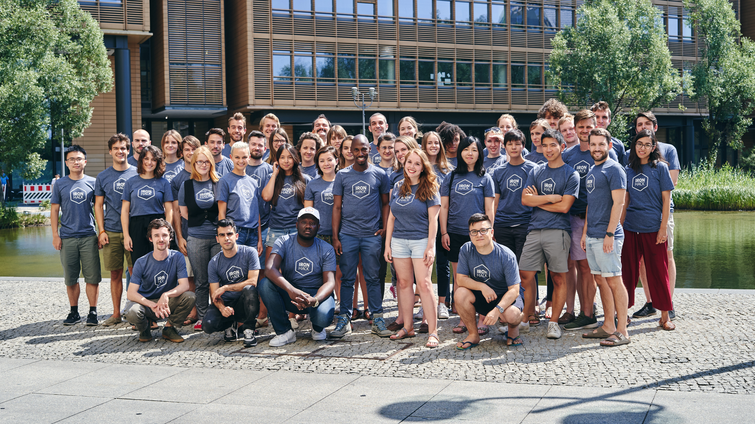

MAIN CONCEPTS

Slide 8

Descriptive Statistics
Measures of Central Tendency:
Which is the single best value to represent your data.
Mean, Median, Mode
Harmonic mean, geometric mean

Slide 9
Descriptive Statistics – Mean and Median
10 | 31 | 17 | 21 | 25 | 17 | 12
Mean
10 | 31 | 17 | 21 | 25 | 17 | 12 | 1000
10 | 12 | 17 | 17 | 21 | 25 | 31
Median
10 | 12 | 17 | 17 | 21 | 25 | 31 | 1000

Slide 10
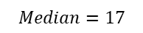
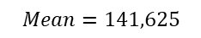
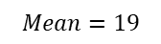
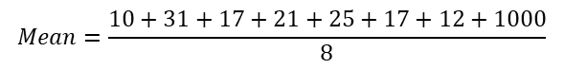

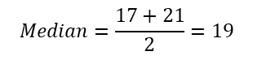
Descriptive Statistics – Mean and Median
$$Mean=\frac{10+31+17+21+25+17+12}{7}$$
10 | 31 | 17 | 21 | 25 | 17 | 12
$$Mean=19$$
$$Mean=\frac{10+31+17+21+25+17+12+1000}{8}$$
10 | 31 | 17 | 21 | 25 | 17 | 12 | 1000
$$Mean=141,625$$
10 | 12 | 17 | 17 | 21 | 25 | 31
$$Median=17$$
10 | 12 | 17 | 17 | 21 | 25 | 31 | 1000
$$Median=\frac{17+21}{2}=19$$

Slide 11
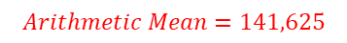
Descriptive Statistics – Mean and Median
$$Mean=\frac{10+31+17+21+25+17+12}{7}$$
10 | 31 | 17 | 21 | 25 | 17 | 12
$$Mean=19$$
$$Mean=\frac{10+31+17+21+25+17+12+1000}{8}$$
10 | 31 | 17 | 21 | 25 | 17 | 12 | 1000
$$Arithmetic Mean=141,625$$
10 | 12 | 17 | 17 | 21 | 25 | 31
$$Median=17$$
10 | 12 | 17 | 17 | 21 | 25 | 31 | 1000
$$Median=\frac{17+21}{2}=19$$

Slide 12
Descriptive Statistics
Measures of Dispersion:
How the data varies? How do they jump around?
Variance, Standard Deviation, Range, InterQuartile Range

Slide 13
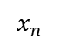
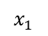
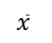
Descriptive Statistics
$$\overline{x}$$
$$x_{1}$$
$$x_{n}$$

Slide 14
Descriptive Statistics
Range = xmax - xmin
$$\overline{x}$$
$$x_{1}$$
$$x_{n}$$

Slide 15
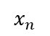
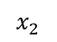
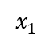
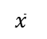
Descriptive Statistics
$$x_{n}$$
$$\overline{x}$$
$$x_{1}$$
$$x_{2}$$

Slide 16
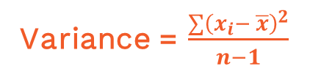
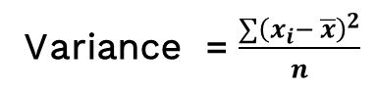
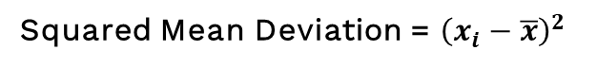

Descriptive Statistics
$$x_{n}$$
Mean Deviation = $(x_{i}−\overline{x})$
Squared Mean Deviation = ${\left(x_{i}−\overline{x}\right)}^{2}$
$$\overline{x}$$
Variance = $\frac{∑{\left(x_{i}− \overline{x}\right)}^{2}}{n}$
$$x_{1}$$
$$x_{2}$$
Variance = $\frac{∑{\left(x_{i}− \overline{x}\right)}^{2}}{n−1}$

Slide 17
Descriptive Statistics
Gaussian Normal Distribution:
Distribution is a formula that tells you how likely a particular value is to occur in your data.

Slide 18
Descriptive Statistics

Slide 19
Descriptive Statistics
Values are equally likely

Slide 20
Descriptive Statistics

Slide 21
Descriptive Statistics

Slide 22
Descriptive Statistics

Slide 23
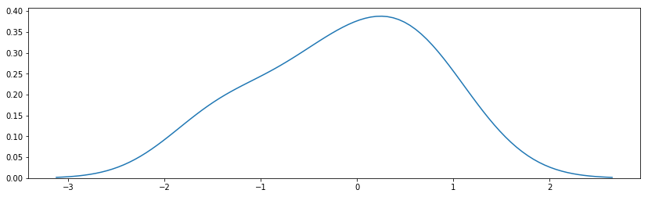
Descriptive Statistics -
https://galtonboard.com/probabilityexamplesinlife

Slide 24
Descriptive Statistics -
https://galtonboard.com/probabilityexamplesinlife
Values close to the mean are more likely.

Slide 25
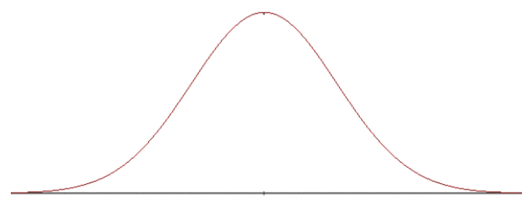
Descriptive Statistics - Gaussian Distribution

Slide 26
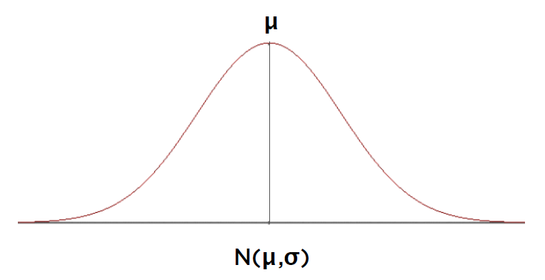
Descriptive Statistics - Gaussian Distribution

Slide 27
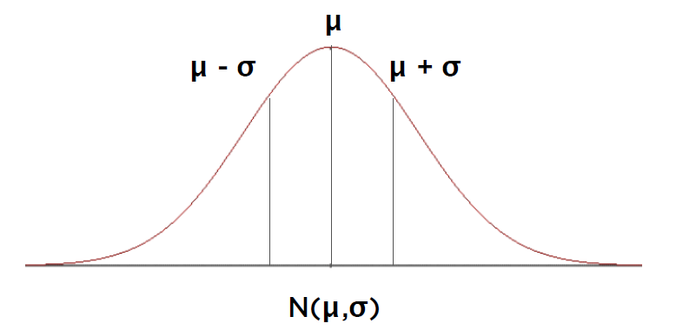
Descriptive Statistics - Gaussian Distribution

Slide 28
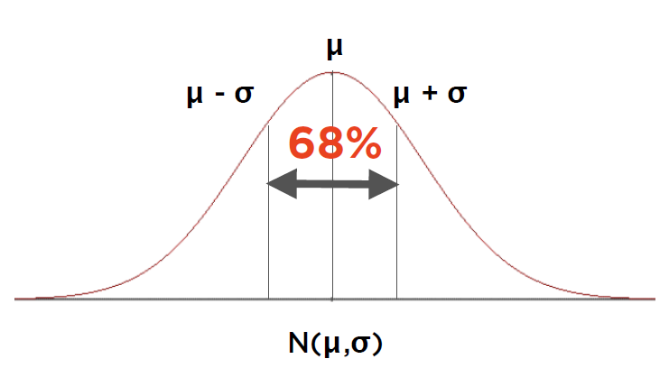
Descriptive Statistics - Gaussian Distribution

Slide 29
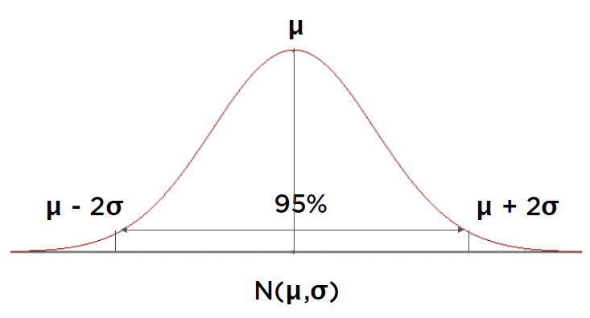
Descriptive Statistics - Gaussian Distribution

Slide 30
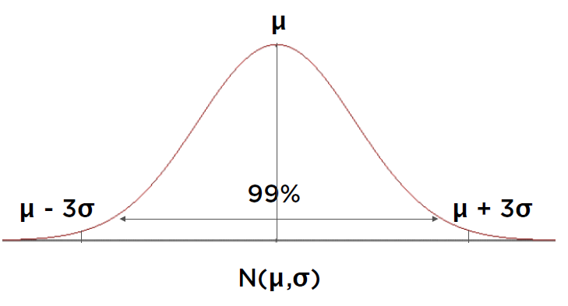
Descriptive Statistics - Gaussian Distribution

Slide 31
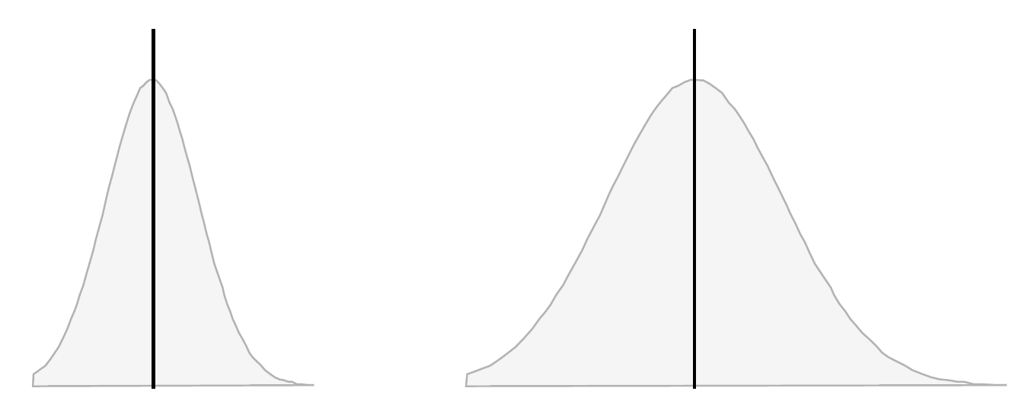
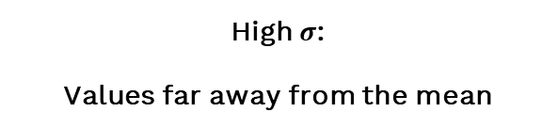

Descriptive Statistics - Gaussian Distribution
Effect of $σ$
Low $σ$:
Values closer to the mean
High $σ$:
Values far away from the mean

Slide 32
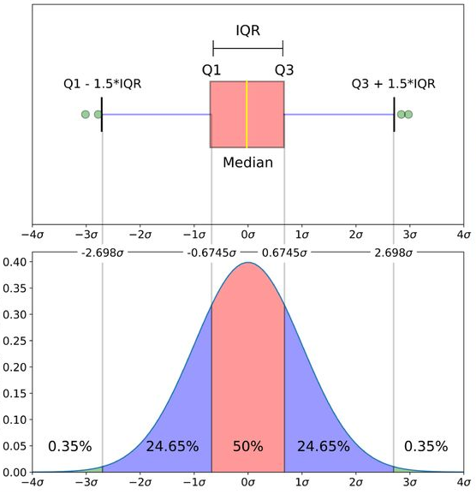
Descriptive Statistics - Gaussian Distribution

